Slide 1
Advanced Game Engine Creation
Introduction to the Module and OpenGL
C++ Review
Lecture 1

Slide 2
Objectives
In this lecture, we will
Introduce the module
Introduce OpenGL
Review C++

Slide 3
Module Introduction
See module handbook on Blackboard site
  module information tab
Module tutors
Learning outcomes
Timetable and independent study
Indicative schedule
Attendance
Resources
Assessment
Academic Integrity
Feedback
Ethics
Module descriptor

Slide 4
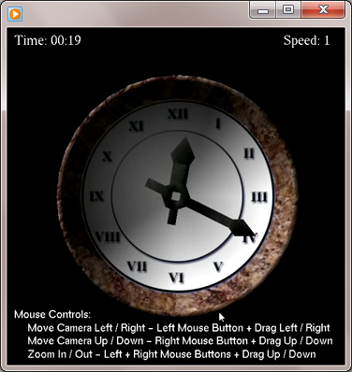
Some 3D scenes

Slide 5
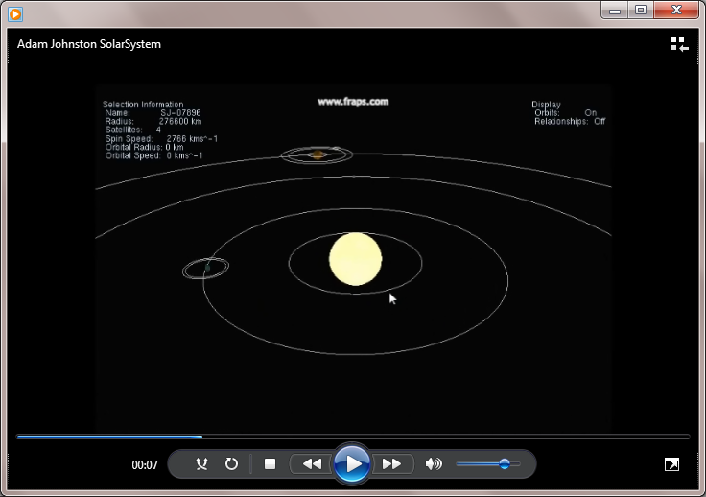
Solar System

Slide 6
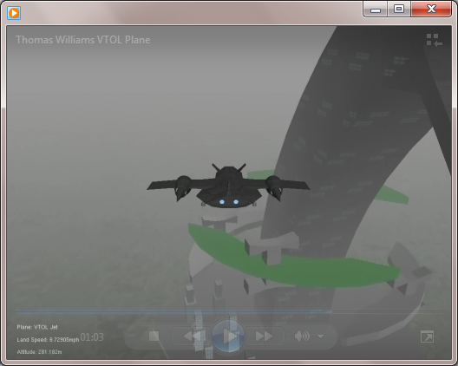
VTOL Plane

Slide 7
WARNING
This module is challenging
But very rewarding
  You will learn a lot which is relevant to your chosen subject
Attend every session and make notes
Work through the examples in the lecture slides
Read more as recommended
Keep up with the practical exercises each week
  this will involve a substantial amount of work beyond the scheduled classes
Ask questions
Don’t get behind
  If you do get behind don’t give up
  Ask for help!

Slide 8
What is OpenGL?
a cross-platform graphics API
  Application Program Interface
allows developers to write 2D and 3D graphics programs without having to write hardware-specific code
  rendering functionality
main competitor – Direct3D
  Microsoft Windows platforms only
widely used in games development, virtual reality, visualisation, CAD
free and open source

Slide 9
OpenGL
Versions of OpenGL are available for every major operating system
  Microsoft Windows
  Apple Mac OS
  Unix X Windows
  OpenGL for Embedded Systems (OpenGL ES) is implemented for Android, iPhone, PS4, PSVita embedded systems....
We will be using an the original version of OpenGL which uses a fixed-function pipeline
and embedding the OpenGL calls within an SDL application

Slide 10
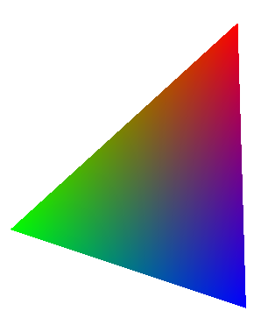
OpenGL triangle
//Clear the screen.
glClear(GL_COLOR_BUFFER_BIT | GL_DEPTH_BUFFER_BIT);
glLoadIdentity();
gluLookAt(0.0f, 0.0f, 10.0f,
0.0f, 0.0f, 0.0f,
0.0f, 1.0f, 0.0f);
glBegin(GL_TRIANGLES);
glColor3f(1.0f, 0.0f, 0.0f);
glVertex3f(2.0f, 2.5f, -1.0f);
glColor3f(0.0f, 1.0f, 0.0f);
glVertex3f(-3.5f, -2.5f, -1.0f);
glColor3f(0.0f, 0.0f, 1.0f);
glVertex3f(2.0f, -4.0f, 0.0f);
glEnd();

Slide 11
C++ review
#include <string>
#include <iostream>
using namespace std;
int main() {
string name;
cout << "What is your name? ";
cin >> name;
cout << "Hello, " << name << "!" << endl;
}

Slide 12
Program Structure
Most problems can be expressed as combinations of
  Sequence
  Selection
    if..
    if..else..
    switch..case...
  Repetition
    for loop
    while loop
    do ... while loop

Slide 13
C++ constructs
sequence, selection, iteration constructs are the same as in Java, C and C#
C++ for loop
  for (int i=0; i < 5; i++) {
  cout << "Hello, " << "!" << endl;
  }

Slide 14
Review - functions
#include <iostream>
using namespace std;
int addNums(int x, int y) {
return x + y;
}
int main() {
int a = 3;
int b = 5;
int answer = addNums(a, b);
cout << a << " + " << b << " = " << answer << endl;
cout << "7 + 6 = " << addNums(7, 6) << endl;
}

Slide 15
C++ Array example
#include <iostream>
#define N 5
using namespace std;
int main( ) {
int num[N];
cout << "Please enter " << N << " integers: ";
for (int i=0; i<N; i++)
cin >> num[i];
for (int i=(N-1); i >= 0; i--)
cout << num[i] << " ";
cout << endl;
}
Please enter 5 integers: 2 4 6 8 10
10 8 6 4 2

Slide 16
C++ Structures
int main() {
PlayerData jim;
jim.health = 1.0;
jim.score = 50;
jim.livesLeft = 3;
PlayerData bob = { 0.75, 100, 5 };
cout << jim.health << " , " << jim.score << ", " << jim.livesLeft << endl;
cout << bob.health << " , " << bob.score << ", " << bob.livesLeft << endl;
}
  #include <iostream>
  using namespace std;
  struct PlayerData {
  float health;
  int score;
  int livesLeft;
  };
  Output:
  1 , 50, 3
  0.75 , 100, 5

Slide 17
Pointer variables
A Pointer variable is used to store an address
  where data of a given type will be stored
int age = 25;
declares a variable which will hold an integer
and stores the value 25 in it
int * pAge;
declares variable which will hold the address of an integer
pAge = &age;
stores the address of the variable age in pAge
Address | name | value
0012FF54 | pAge | 0012FF60
0012FF60 | age | 25

Slide 18
Pointer variables
int main() {
int age = 25, *pAge, y;
  pAge = &age;
  y = *pAge;
  (*pAge)++;
  pAge = &y;
}
address | name | value | new value
0012FF48
0012FF54
0012FF60
y
25
pAge
0012FF60
0012FF48
age
25
26

Slide 19
Pointer variables
int main() {
int age = 25, *pAge, y;
  pAge = &age;
  y = *pAge;
  (*pAge)++;
  pAge = &y;
}
we are not interested in the memory address stored by a pointer variable
just that it points to a particular place in memory
address | name | value | new value
0012FF48
0012FF54
0012FF60
y
25
pAge
age
25
26

Slide 20
Dynamic memory
the real value of pointers is their use to point to heap memory
  following dynamic memory allocation
without dynamic memory, all variables are created on the stack
and go out of scope when the code block ends

Slide 21
PlayerData * inputData() {
PlayerData * p = new PlayerData;
cout << "Please enter health (0-1.0), score and lives left: ";
cin >> p->health;
cin >> p->score;
cin >> p->livesLeft;
return p;
}
void outputData(PlayerData * p) {
cout << p->health << " , " << p->score << ", " <<p->livesLeft <<endl;
}
int main() {
PlayerData * thePlayer;
thePlayer = inputData();
outputData(thePlayer);
delete(thePlayer);
}
Please enter health (0-1.0), score and lives left: 0.25 4 5
0.25 , 4, 5

Slide 22
Returning a newly created struct
PlayerData * inputData() {
PlayerData * p = new PlayerData;
cout << "Please enter health (0-1.0), score and lives left: ";
cin >> p->health;
cin >> p->score;
cin >> p->livesLeft;
outputData(p);
return p;
}
int main() {
PlayerData * thePlayer;
thePlayer = inputData();
outputData(thePlayer);
delete(thePlayer);
}
heap
3
livesLeft
score
health
10
0.25
stack
…
….
p
thePlayer

Slide 23
Deallocating objects
we don't need to worry about the PlayerData struct going out of scope
it will stay on the heap forever
or until the program terminates
  if we are lucky
It is important to release heap memory once it is no longer required
Otherwise we have a memory leak
  the memory is not available to allocate again
  new memory will be harder to find
  eventually all the heap memory will fill up and the program will crash

Slide 24
Summary
Today we have
introduced the module
introduced OpenGL
quickly reviewed C++
Practical
Introduction to framework including OpenGL
using library functions to display 3D shapes
Further work
Read Blackboard site, including module handbook
Review your notes from last year, particularly C++!!!

